Slide 1
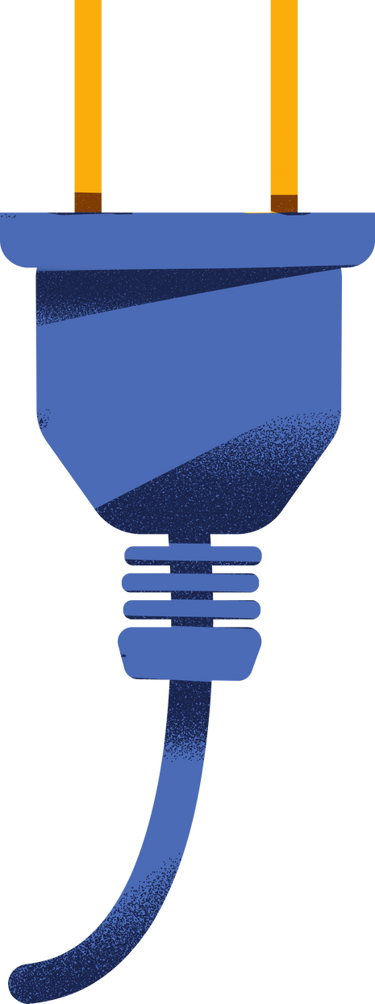
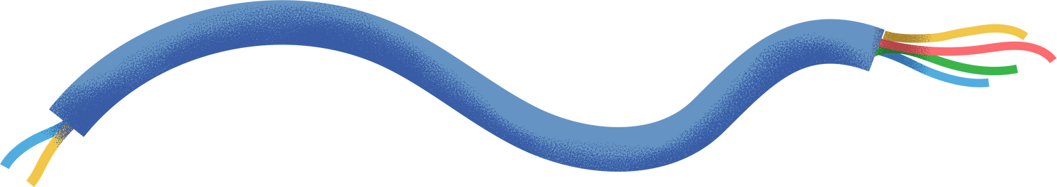
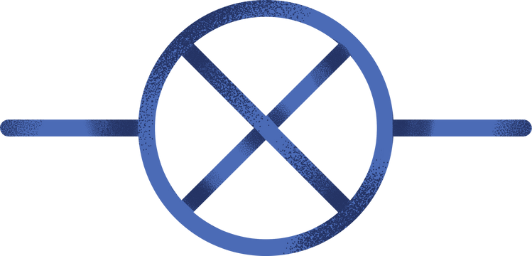

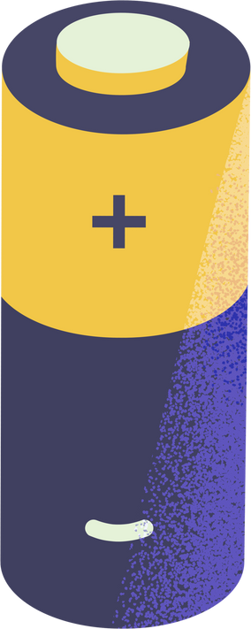
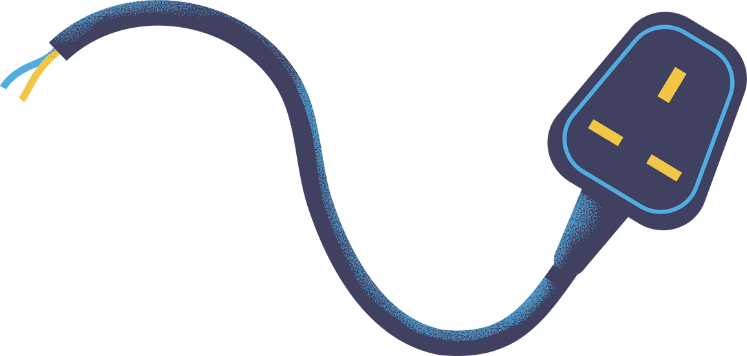
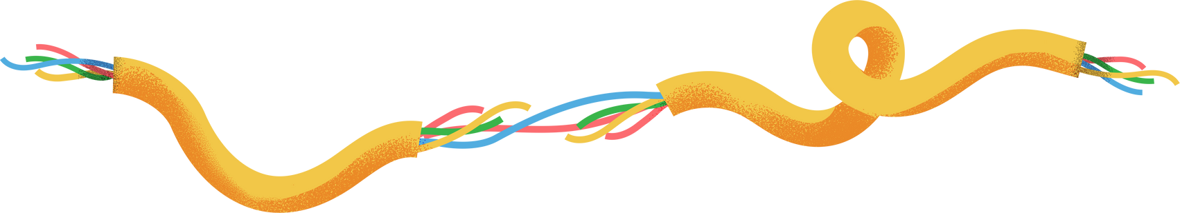
RC Highpass Filter
Exploring the components of a RC Highpass Filter Circuit

Slide 2
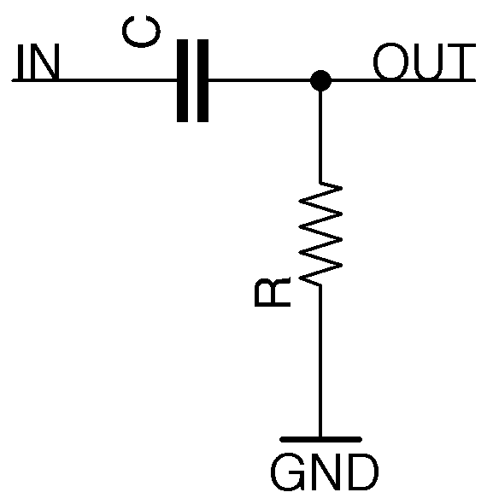
RC HIGHPASS FILTER
Required Components:
Resistor (R)
Compositor (C)
Input Signal (IN)
Output Load (Out)
Power Supply (GND)

Slide 3
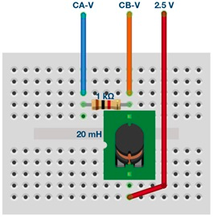
What does it do??
Example
Function
An RC (Resistor-Capacitor) high-pass filter is an electronic circuit or filter design that allows high-frequency signals to pass through while attenuating or blocking low-frequency signals. It is one of the simplest types of passive filters used in electronics. The RC high-pass filter is based on the interaction between a resistor (R) and a capacitor (C).
Notes:
The RC Highpass Filter, composed of a resistor (R) and a capacitor (C), operates based on the principles of frequency-dependent impedance and time constants. Its primary purpose is to allow high-frequency signals to pass while attenuating low-frequency signals.
At low frequencies, the resistance to the flow of alternating current of the capacitor is high due to its capacitive reactance (Xc = 1 / (2πfC)), where 'f' is the frequency and 'C' is the capacitance. This high impedance effectively blocks low-frequency signals.
The resistor's resistance to the alternating current of the capacitor is constant and equal to its resistance (R) at all frequencies.
When a signal is applied to the input of the RC Highpass Filter, the high-frequency components encounter lower resistance from the capacitor compared to the resistor. Therefore, most of the high-frequency signal voltage appears across the output. In contrast, the low-frequency components experience higher resistance from the capacitor, causing significant voltage drop across the resistor, effectively attenuating these low-frequency signals.
The point where the filter begins to significantly attenuate signals is known as the "cut-off frequency" (fc). It is defined as fc = 1 / (2πRC). Frequencies above this point are allowed to pass with minimal attenuation, while frequencies below it are progressively attenuated.

Slide 4
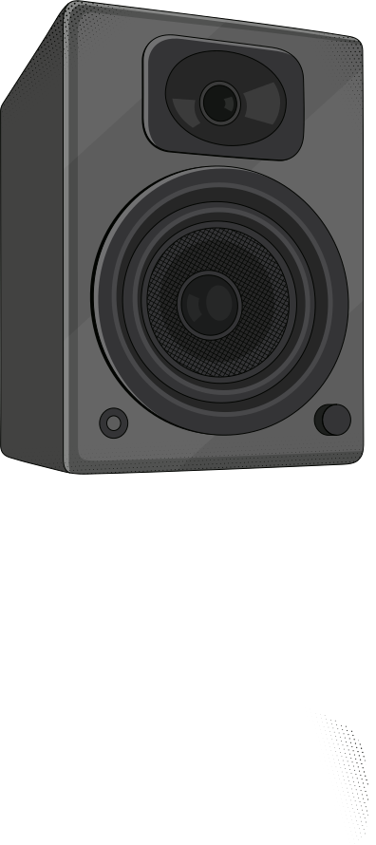
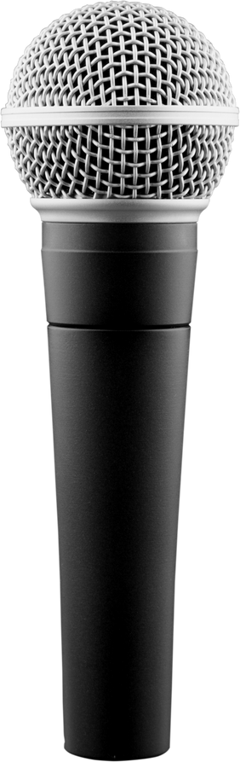
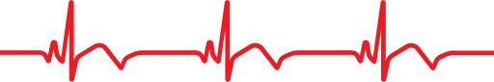
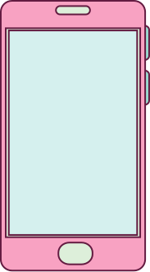
Real World Usage
Audio Systems
Biomedical Signal Processing
Wireless Communication Devices
Notes:
In audio systems, the RC Highpass Filter is used to remove unwanted low-frequency rumble or noise from audio signals. For instance, a subwoofer crossover network uses an RC highpass filter to ensure that only high-frequency audio signals are sent to the main speakers, while the low-frequency signals are directed to the subwoofer for better bass reproduction.
In biomedical signal processing, an RC highpass filter can be employed to remove baseline drift from electrocardiogram (ECG) signals. This ensures that the relevant high-frequency components representing heart activity are retained while eliminating slow-varying artifacts.
In wireless communication systems, RC highpass filters can be used to eliminate low-frequency interference or noise from incoming signals. For instance, in a mobile phone receiver, an RC highpass filter may be utilized to filter out background noise or interference in the audio signal, improving call quality.

Slide 5
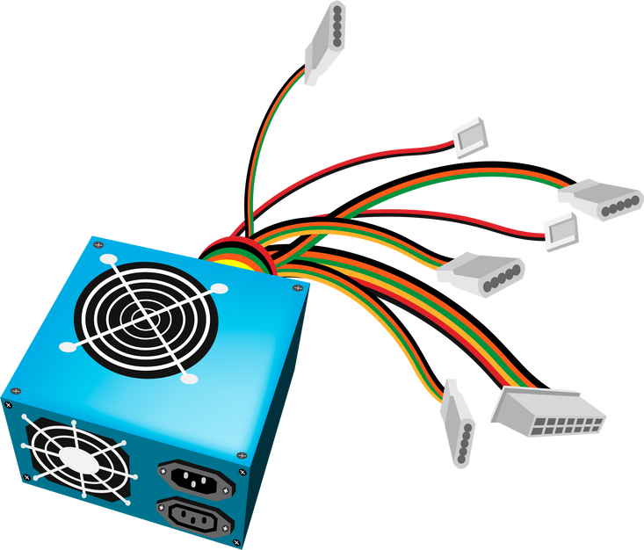
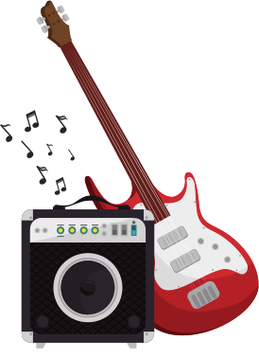
Real World Usage
Power Supplies
Professional Studios
Notes:
In DC power supplies, an RC highpass filter can be used to filter out any AC ripple or noise in the output voltage, ensuring a cleaner and more stable DC voltage supply.
In professional audio setups, RC highpass filters are used in graphic equalizers to tailor the frequency response of sound systems. This helps in reducing unwanted low-frequency resonance or hum in auditoriums or recording studios.

Slide 6
Advantages
Simplicity
Low Cost
Effectiveness in Blocking Low-Frequency Noise:
Ease of Integration:
Smooth Frequency Roll-off
Low Power Consumption
Notes:
Simplicity: The RC Highpass Filter is one of the simplest passive filters to design and implement. It consists of only two passive components, a resistor (R) and a capacitor (C), making it accessible even for those with basic electronics knowledge. Its simplicity lends itself well to various applications.
Low Cost: The components required for an RC Highpass Filter are readily available and inexpensive. This affordability makes it an attractive choice, especially in cost-sensitive applications where complex filter circuits with active components might not be economically viable.
Effectiveness in Blocking Low-Frequency Noise: The primary purpose of an RC Highpass Filter is to attenuate or block low-frequency signals, including noise and interference. Its ability to effectively eliminate low-frequency noise makes it valuable in applications where signal quality is critical, such as audio systems and communication devices. This noise reduction improves the overall performance of the circuit.
Ease of Integration: RC Highpass Filters can be easily integrated into existing circuits or systems. They can serve as standalone filters or be part of more complex circuitry without significantly complicating the design. This versatility makes them suitable for a wide range of applications.
Smooth Frequency Roll-off: The frequency response of an RC Highpass Filter exhibits a gradual roll-off as frequencies move away from the cut-off frequency. This gradual attenuation helps avoid abrupt changes in signal characteristics, which can be desirable in some applications, such as audio systems, where sharp cutoffs might introduce audible artifacts.
Low Power Consumption: Passive components, such as resistors and capacitors, used in RC Highpass Filters consume very little power. This is advantageous in battery-powered devices and low-power applications where energy efficiency is a concern.

Slide 7
Disadvantages
Limited Selectivity
Phase Shift
Sensitivity to Component Tolerances
Frequency Range Limitation
Signal Attenuation
DC Blocking
Notes:
Limited Selectivity: One of the main drawbacks of the RC Highpass Filter is its limited selectivity or sharpness of cutoff. As frequencies approach the cutoff frequency (fc), the attenuation of low-frequency signals is not abrupt but rather gradual. This means that some low-frequency components may still pass through at reduced amplitudes, which can be undesirable in applications requiring precise frequency separation.
Phase Shift: The RC Highpass Filter introduces phase shift to the passing signals. At the cutoff frequency, the phase shift is approximately 45 degrees, and it continues to increase with higher frequencies. In applications where phase coherence is critical, such as in audio systems or communication devices, this phase shift can lead to undesirable effects like distortion or signal misalignment.
Sensitivity to Component Tolerances: The performance of the RC Highpass Filter is sensitive to the tolerances of the resistor (R) and capacitor (C) values used. Small variations in component values can lead to deviations in the cutoff frequency and the filter's overall behavior. This sensitivity can make precise filter tuning challenging and may require careful component selection or additional calibration.
Frequency Range Limitation: The RC Highpass Filter is best suited for low to moderate frequencies. It becomes less effective as the frequency range extends to very high frequencies due to the limitations of practical component values and inherent parasitic capacitances and inductances.
Signal Attenuation: While the RC Highpass Filter effectively attenuates low-frequency signals, it may also attenuate some high-frequency components, depending on the specific application and filter design. This can lead to signal distortion or loss of information in certain cases.
DC Blocking: In some applications, the RC Highpass Filter may inadvertently block DC (direct current) components, which can be problematic if DC information needs to be preserved in the signal.

Slide 8
Variations of an RC Highpass Filter
Mutiple Stage Fillers
Active Highpass Filters:
Customized Component Values
Switched-Capacitor Filters
Active-RC Filters
Notes:
Multiple-Stage Filters:
Multiple-stage RC Highpass Filters consist of two or more RC filter stages connected in series. Each stage introduces additional attenuation and phase shift, resulting in a steeper overall cutoff slope and improved selectivity. Multiple-stage filters are preferred when a sharper cutoff is required, and there's a need to attenuate low-frequency signals more effectively. They are often used in applications where precise frequency separation is critical, such as audio crossovers or signal analyzers.
Active Highpass Filters:
Active Highpass Filters incorporate operational amplifiers (op-amps) into the filter design to provide amplification and better control over filter parameters. Op-amps can be used to overcome the limitations of passive RC filters, such as gain, impedance matching, and adjustable cutoff frequencies.
Active highpass filters are preferred when there's a need for gain, improved control over filter characteristics, or when the RC passive filter alone cannot meet the application's requirements. They are commonly used in active audio equalizers and precision signal processing.
Customized Component Values: In some cases, the RC Highpass Filter's component values (resistor and capacitor) can be customized to achieve specific cutoff frequencies and impedance levels. This allows engineers to tailor the filter's performance to match the application's requirements precisely.
Customized component values are preferred when the standard RC filter formula doesn't yield the desired cutoff frequency or when impedance matching is crucial. This approach is often used in research and specialized applications where precise control over filter parameters is necessary.
Switched-Capacitor Filters:
replace the continuous analog components with switched capacitors and digital control. These filters offer excellent flexibility in terms of adjustable cutoff frequencies, low component sensitivity, and reduced power consumption. Switched-capacitor filters are preferred when digital control and fine-tuning of the cutoff frequency are required. They find use in modern communication devices and integrated circuits for their programmability and versatility.
Active-RC Filters:
Description: Active-RC filters combine the advantages of active filtering (using operational amplifiers) with the RC filter structure. These filters offer precise control over parameters, low output impedance, and the ability to create high-order filter responses. Active-RC filters are preferred when precise control, low output impedance, or high-order filter designs are needed. They are commonly used in instrumentation and audio processing applications.

Slide 9

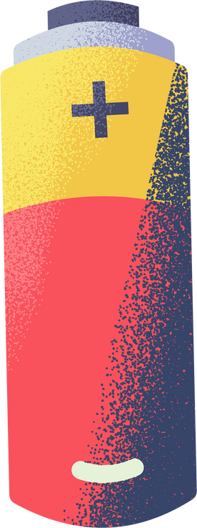
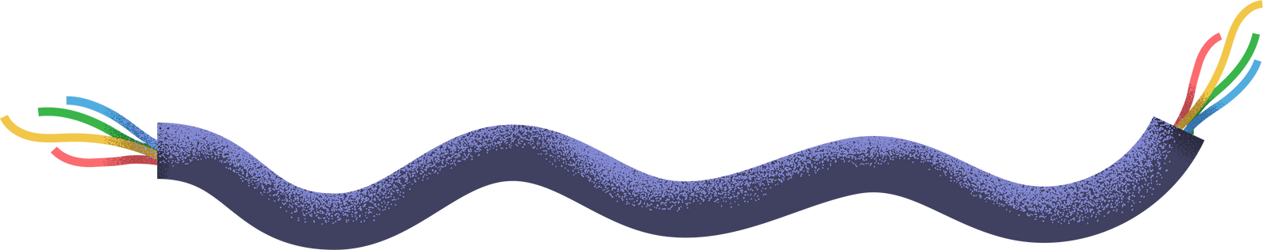
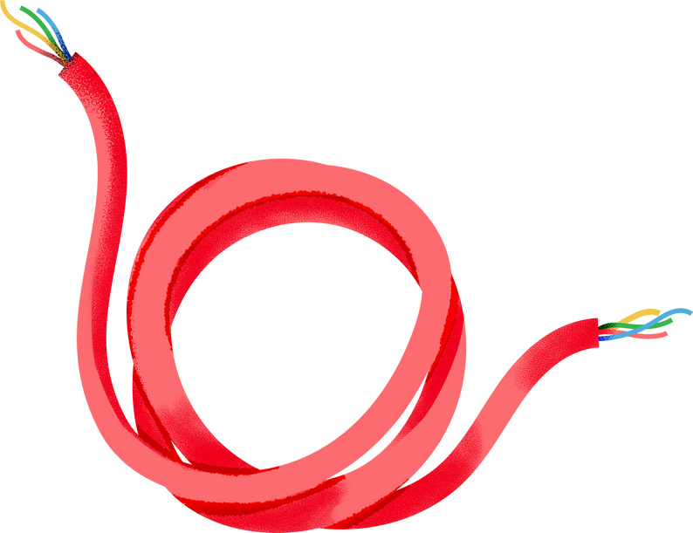
References
Altunian, G. (2020, March 11). What is a high pass filter?. Lifewire. https://www.lifewire.com/high-pass-filter-3134730
Determining cut-off frequency and transfer function of RC high-pass filters - technical articles. EEPower. (n.d.). https://eepower.com/technical-articles/determining-cut-off-frequency-and-transfer-function-of-rc-high-pass-filters/#
Mercer, D., &amp; Miclaus, A. (2019, November 15). ADALM1000 SMU training topic 10: Low pass and high pass filters. Analog Devices. https://www.analog.com/en/analog-dialogue/studentzone/studentzone-october-2018.html
YouTube. (2016, June 21). RC high pass filter circuit. YouTube. https://www.youtube.com/watch?v=QPAg7Xh6enQ

